Slide 1
Extending AES to 192- and 256- bits
By
Dixita Sharegar
Saranya Radhakrishnan

Slide 2
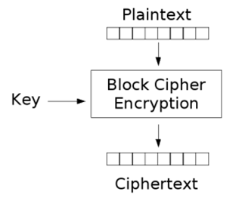
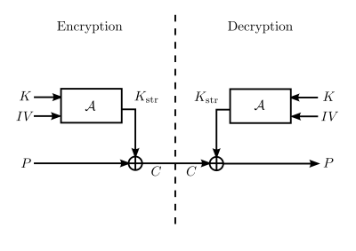
Advanced Encryption Standard (Aes)
Symmetric block cipher

Slide 3
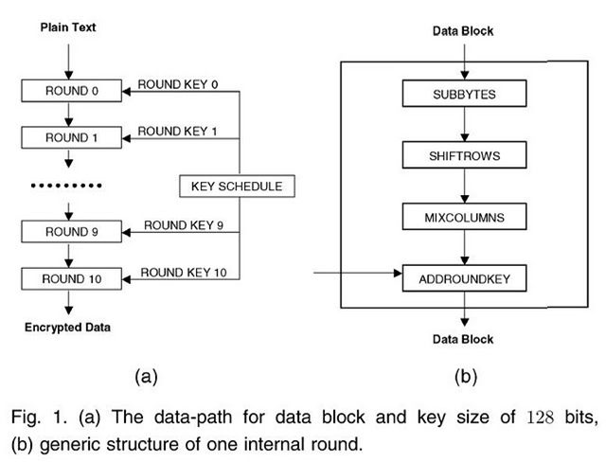
ENCRYPTION

Slide 4
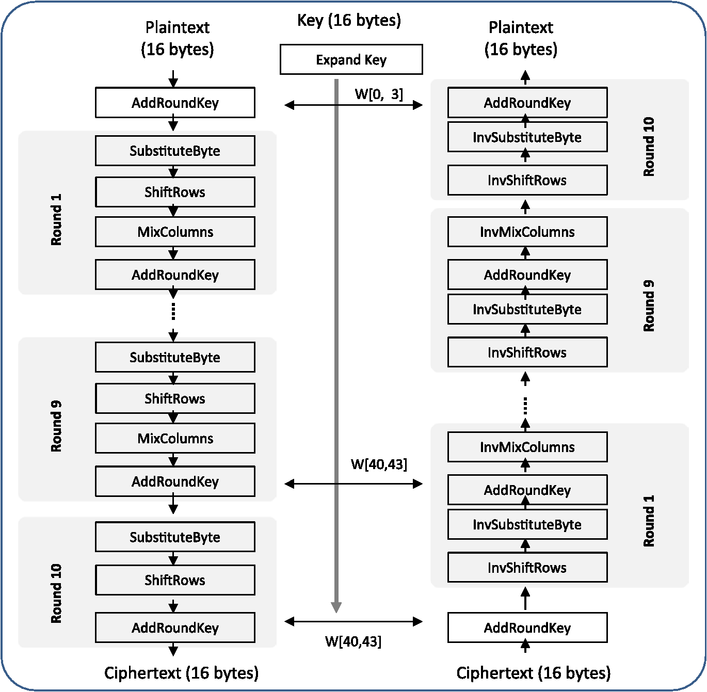
DECRYPTION

Slide 5
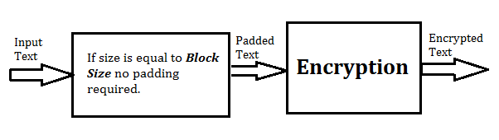
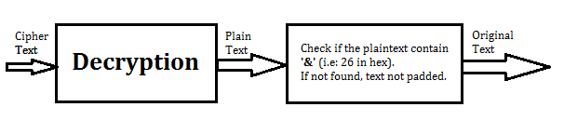
PADDING
If InputSize == BlockSize

Slide 6
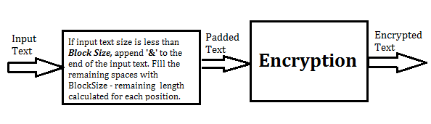
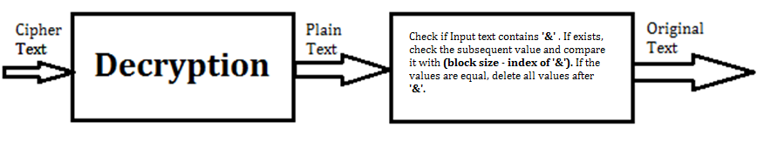
PADDING
If InputSize < BlockSize

Slide 7
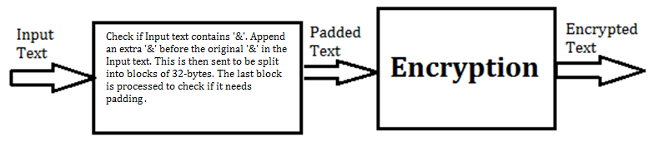
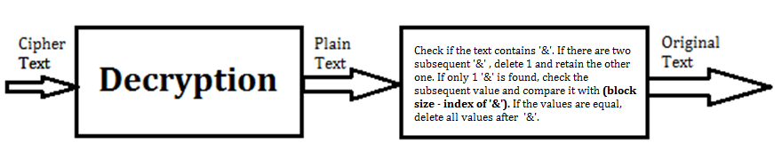
PADDING
If InputSize > BlockSize

Slide 8
demo
Open Code Location For Demo

Slide 9
Authentication technique

Slide 10


Slide 11


Slide 12
REFERENCES
Block Cipher Image
Symmetric Block Cipher Image
Encryption Steps Image
Decryption Steps Image
Q & A Image
Encryption & Decryption Algorithm Paper
Thank You Image

